Slide 1
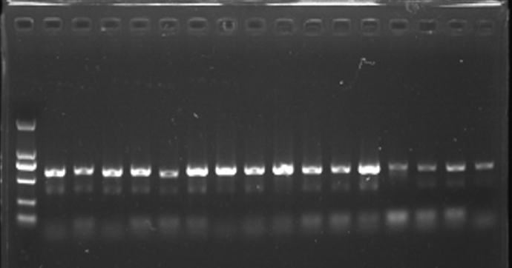
Clinical characteristics and pathogenic spectrum of pulmonary filamentous fungal infection in AIDS patients in Guangdong area
Cao Yi^{1, #}, Liu Fanglan^{2，#} , Gong Dandan¹ , Hu Fengyu¹ , Chen Wanshan¹ , Cai Weiping¹ , Tang Xiaoping¹ , Li Linghua^{1,*}.
From the ¹Guangzhou Eighth People's Hospital,Guangzhou Medical University, Guangzhou, China ; ²Guangzhou Red Cross Hospital ,
Corresponding author: Li Linghua, Address: No.627 Dongfeng Dong Road, Guangzhou,China E-mail address: llheliza@126.com
• BACKGROUNFD
To explore the clinical features and pathogenic spectrum of pulmonary filamentous fungal infection in AIDS patients in Guangdong, providing with evidence for improving the level of diagnosis.
• METHODS
143 filamentous strains were identified with molecular biological method, obtained from the culture of bronchoalveolar lavage fluid (BALF) of 143 AIDS cases complicated with pneumonia in Guangzhou Eighth People's Hospital, and their clinical characteristics were analyzed.
• RESULTS
There were 115 males and 28 females with an average age of (42.3±1.0) years. Of the 143 patients, 116 (81.1%) had fever and 46(32.2%) had skin lesions. The main respiratory symptoms consisted of cough (72.7%), expectoration (58.0%), and anhelation (41.3%). The primary laboratory abnormalities included leukopenia (36.4%), leukocytosis (12.6%), anemia 76.2%), thrombocytopenia (20.3%) and galactomannan (GM) test was positive (44.8%). The median CD4⁺ T
lymphocyte count was 22 (9.3, 60.8) cells/μl and 82.5% below 100 cells/μl.
Table 1 Molecular biological identification results of 143 strains of AIDS pulmonary infection
The major abnormalities of chest CT manifested as diffuse infection (79.7%), pleural effusion (30.8%), thoracic lymphadenopathy (31.5%) and miliary lesions (8.4%). After receiving antifungal therapy, 124 patients (86.7%) were cured or improved on discharge, and 19 cases (13.3%) were discharged due to deterioration or died. Of 143 isolates, 56 were identified as Aspergillus spp. (39.2%), 37 were Talaromyces marneffei (TM) (25.9%), 22 were Penicilium spp. (15.4%), and 28 were other genera of filamentous fungi (19.6%). The CD4⁺ cell counts of different genus infections were listed from the highest to the lowest as follows: Penicillium spp. (53.5 cells/μl), Aspergillus spp. (24.5 cells/μl), other genera (22 cells/μl) and TM (15 cells/μl) (P<0.05); When CD4⁺ cell count ≤50 cells/μl, TM dominated(89.2%), and when CD4⁺ cell count >50 cells/μl Penicilium spp.(45.5%) accounted for a large proportion.
• CONCLUSION
The clinical manifestations of pulmonary filamentous fungal infection in AIDS patients in Guangdong lack specificity with diverse pathogenic spectrum, mainly consisting of TM and Aspergillus fumigatus. Meanwhile, the distribution of fungi was related to CD4⁺ T cell count.
Genera | Numbers | The species of fumigatus
Aspergillus spp. | 56 | A.fumigatus(24)，A.versicolor(5)，A.sydowii(2)，A.niger(8)，A.aculeatus(6)， A.carbonarius(1)，A.ochraceus(1)，A.restrictus(1)，A.nomius(1), A.flavus(7)
TM | 37 | Talaromyces marneffei(37)
Penicilium spp. | 22 | P.citrinum(1), P.griseofulvum(1)，P.sclerotiorum(4)，P.oxalicum(3)，P.meleagrinum(3)， P.glabrum(1)，P.commune(1)，P.digitatum(1)，P.herquei(2)，P.citreonigrum(1)， P.piceum(1)，P.verruculosum(1)，P.minioluteus(1)，P.roseopurpureum(1)
others | 28 | Cladosporium sp.(7)，Paecilomyces sp.(6)，Trametes hirsuta(1)，Trametes. versicolor(1)， Schizophyllum commun(3)，Coprinellus radians(3)，Alternaria brassicae(1)，Epicoccum nigrum(1)，Hypoxylon fragiforme(1)，Phanerochaete chrysosporium(1)，Phoma sp.(2)， Gibberella moniliforme(1)
Table 2 Distribution and composition ratio of fungal flora under different CD4+T lymphocyte count levels
CD4T lymphocytes | Aspergillus spp. | Penicilium spp. | TM | others | total
≤50 | 38(67.9) | 12(54.5) | 33(89.2) | 19(67.9) | 102(71.3)
>50 | 18(32.1) | 10(45.5) | 4(10.8) | 9(32.1) | 41(28.7)
total | 56(100.0) | 22(100.0) | 37(100.0) | 28(100.0) | 143(100.0)
2000bp
1000bp
750bp
500bp
200bp
100bp
Figure 1 Electrophoresis of rDNA-ITS PCR amplification products of some filamentous fungi
Figure 2 Distribution of CD4 cell count in AIDS patients with different pneumonia fungi
Figure 3 Pathogenic spectrum distribution of pulmonary filamentous fungal infection with different CD4+ cell counts

